Slide 1
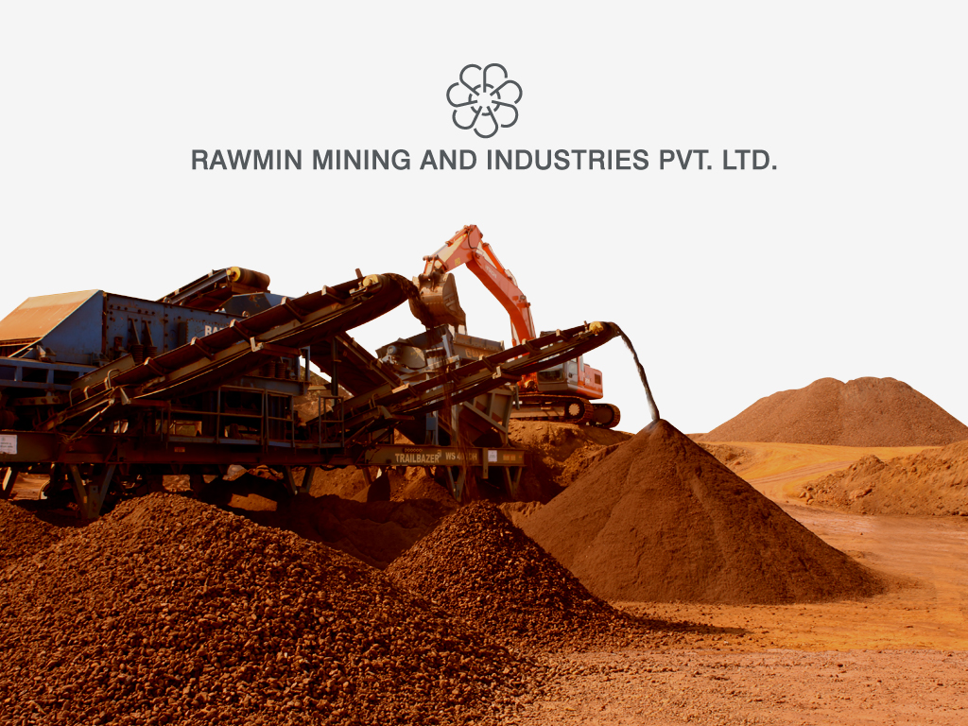

Slide 2
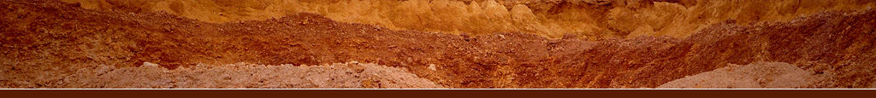
COMPANY PROFILE
Company | Rawmin Mining And Industries Pvt. Ltd.
Constitution | Private Limited Company
Sector | Mining and Manufacture of Mineral Based Value added Products
Business activities | Mining and Exports of Bauxite and Iron Ore.
Board of Directors | Mr. Mahesh J. Thanki Mr. Bhargav G. Thanki Mr. Bhavin H. Thanki

Slide 3

COMPANY AT A GLANCE
Family Owned Private Mining Company promoted by third generation entrepreneurs
Mine Owner and Exporter of Bauxite from India
Government of India Recognized Star Export House
A strong governance structure
Long-life, low-cost, export-oriented and value added mineral assets
Worldwide Delivery of Minerals in an ethically and socially responsible manner
Synergy of mining, value addition, logistics and quality control
Improved risks management
Care of the environment and betterment of local communities
Easier access to land, people and capital, the three critical resources on which our business success is built

Slide 4
FOUNDATIONS FOR SUCCESS
BACKGROUND
The parent company Saurashtra Minerals Pvt. Ltd. commenced Business of
mining in the year 1951
MANAGEMENT
Managed by third generation entrepreneurs in mining business. Closely held Family owned Private Company.
ADVISORY COMMITTEE
Qualified Geologists
Mining Engineers
Financial Executives
MINING TEAM
Strong and dedicated team of professionals carrying out scientific mining using the latest technologies in an environment friendly manner
QUALITY CONTROL
International standards for Quality in
Mining
Processing
Logistics
Export

Slide 5
Sr. No. | Valued Customers of Rawmin | Products
1 | Glencore International AG, Switzerland | Metallurgical Grade Bauxite
2 | Minermet SA, Switzerland
3 | Middle East Mining Resources, UAE
4 | Dadco Alumina & Chemicals Ltd., Germany
5 | Vimetco N.V.,Netherlands
6 | Azeral Azarbaijan
7 | Nippon Light Metal, Japan
8 | Age Trading FZC, UAE
9 | Commercial Metals Company, USA
10 | Saudi Cement Co., Saudi Arabia | Cement Grade Bauxite
11 | Gulf Cement Company, Qatar
12 | Eastern Province Cement Co., Saudi Arabia
13 | Union Cement, UAE
14 | Gulf Cement, UAE
15 | National Cement, UAE
16 | Samsung C & T Corporation, Korea | Iron Ore
17 | Rudhra Minerals Pte. Ltd. Singapore

Slide 6
Year | Milestones
1951 | Incorporation of the parent company- Saurashtra Minerals Pvt. Ltd. as the Pioneer Mining Company In Gujarat State, India
1981 | Rawmin Trade Agencies was established to export Bauxite in the international market. It performs maiden shipment of Bauxite to UAE during this year
1982-1998 | Rawmin continues its growth and establishes itself as a leading exporter of Cement Grade Bauxite from India
1999 | Rawmin effects its first Metallurgical Grade Bauxite export shipment from India to Japan
2001-02 | Rawmin is registered as a 100% Export Oriented Unit (EOU) with the Government of India. Rawmin sets up its Bauxite Beneficiation Plant to manufacture the finest quality of Beneficiated Bauxite for metallurgical end use
2003-04 | Export House Recognition Granted by the Government of India. Rawmin undertakes its export operations as a 100% Export Oriented Unit (EOU)

Slide 7
Year | Milestones
2003-2008 | Rawmin undertakes detailed identification, prospecting and survey of potential Bauxite bearing areas in Maharashtra State in India
2004-2008 | Rawmin continues its growth and establishes itself as a leading exporter of Metallurgical Grade Bauxite worldwide to various end users in Ukraine, Romania, Germany, China and Azerbaijan.
2008 | Rawmin executes Memorandum of Understanding with the Government of Maharashtra to setup an Alumina Refinery in Maharashtra State
2010 | Rawmin ventures into export of Iron Ore from Goa, India. Rawmin acquires strategic port based warehousing sites and areas for its mineral exports from Goa
2012-2016 | Rawmin continues its Bauxite export operations on a larger scale to China
2015 | Government of India promulgates MMDR Amendment Act 2015 and introduces long pending reforms in the mining sector
2015 | Rawmin executes long term Bauxite offtake agreement with ABx

Slide 8
MINING RESERVES
Bauxite Reserves | State | Million MT
Existing Bauxite Reserves in India | Maharashtra | 12.00
 | Gujarat | 9.50

Slide 9
CONTACT US
Mumbai
Goa
Gujarat
94 - A, Mittal Court
224, Nariman Point
Mumbai - 400 021
India
Tel : + 91-22-22829191-92
Fax : + 91-22-22829193
Email: bhargav@rawmin.com
615, Gera's Imperium - II
Patto Plaza
Panaji – 403 001
Goa
India
Tel: +91-832-2970099
Fax: +91-832-2970076
Email: mahesh@rawmin.com
East Kadia Plots
Porbandar-360 575
Gujarat
India
Tel : +91-286-2241108
Fax : +91-286-2245237
Email: bhavin@rawmin.com
www.rawmin.com

